Slide 1


Code Reviews - Establishing a Quality Culture
Jayesh Kawli
iOS Developer @Wayfair
@jayeshkawli
Notes:
I am Jayesh Kawli, Senior iOS engineer at Wayfair. Wayfair is a e-commerce company selling furniture situated in Boston with office in Berlin
In my spare time I write blog and cook food
Recently started taking Spanish lessons
Today we’re going to talk about Code review and how they help establish the quality culture within the organization

Slide 2
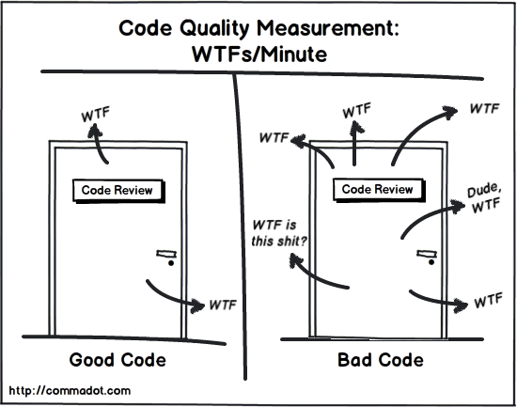
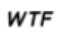
What is Code Review?
Notes:
Slide is the exaggeration of how code reviews take place
Our goal should be to convert the code on the right side to the left side
A great learning opportunity based on how strict the review goes
No matter who wrote the code, in most cases there is always the possibility to improve it so even if you get few comments on code, that is better than no comment on MR of reasonable size
One more thing, we at Wayfair use the word MR - Merge request quite so often. Due to habit, I might use it throughout the presentation, but it will mean the same thing as PR – pull request. A request to merge feature or bug-fix into the parent branch.
At Wayfair we have two main branches develop which offers the bleeding edge snapshot of development and release branch represents the code that will be released in the next cycle. Anyone can review and comment on merge requests. In fact reviewing merge requests from other teams is educational and is highly recommended

Slide 3
What is Code Review?
The process of systematically inspecting the code written by another developer
An ecosystem promoting collaboration
Notes:
to make sure code is thoroughly assessed and confidently deployed
An ecosystem promoting collaboration -- Leading to the sharing of technical expertise and domain knowledge among team members
In fact it is so important that everybody should be doing code reviews
I "review" my own code in the MR/PR tool before sending it to other developers.

Slide 4
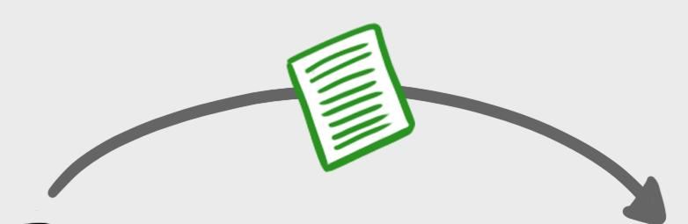
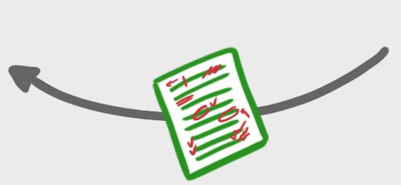
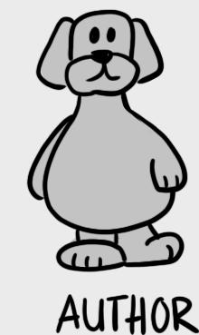
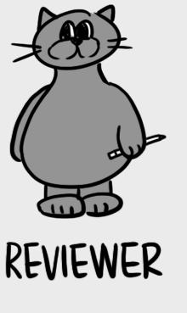
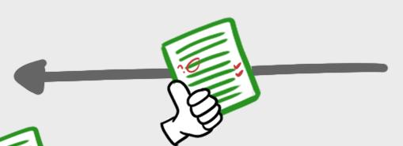


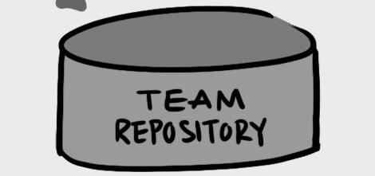
What is Code Reviewing?
- Michael Lynch, https://mtlynch.io/
Notes:
There could be multiple reviewers, but for the sake of example, we will assume the simplified case
Split the image into individual components

Slide 5
Why do we need it?

Slide 6
Why do we need it?
It can help teams catch bugs at early stages
A means to enforce quality standards
Notes:
*
A means to enforce quality standards -- And ensuring code conforms to code guidelines and style document
Preferred method would be to hook linters / code formatters up to the submission pipeline to make most of those kinds of changes unnecessary

Slide 7
Why do we need it?
A great platform for knowledge sharing
Should you care about other people looking at your code? – Yes!
Notes:
- A great platform for knowledge sharing -- With team members
*
Code reviews do not mean you are not trustworthy – It’s just to make sure code is properly written, it provides learning opportunity and adheres to quality standards and guidelines

Slide 8


Many ways to do Code Reviews
🤝
👀
💻
👀
✍️
Notes:
Make it four eyed

Slide 9
Key factors in code review
Does code adhere to the best coding practices?
Is code secure and free from potential exploits?
Is code maintainable and adaptable?
Notes:
Does code adhere to standard coding practices
Adding doc comments to the newly written piece of code
Properly implementing underlying code architecture
- Is code maintainable and adaptable -- Enough to handle all possible edge cases?

Slide 10
Key factors in code review
Is this code tested to a reasonable extent?
Does code contain redundancy?
Notes:
- Assuming CI is setup, does this code break or fail any previously working and successful tests
- Does code contain deprecated comments, necessary TODOs, and orphan sections?

Slide 11
Code Review - Examples

Slide 12
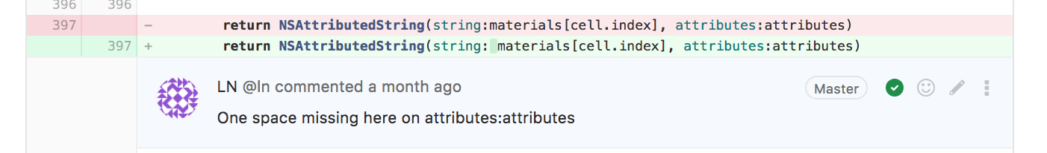
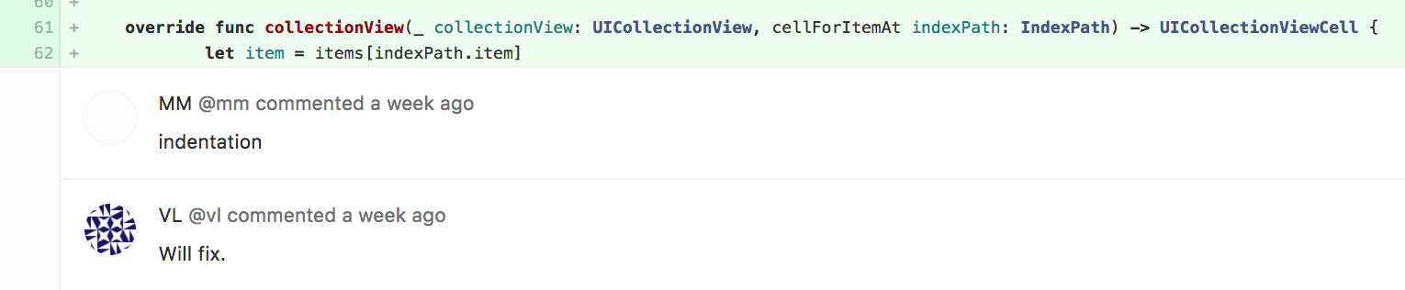
Code Style
Notes:
Does this code adhere to standard styles document? Sometimes linters fail to catch exceptional or complex style violations which can be caught by the manual inspection
https://git.csnzoo.com/wayfair/wayfair-ios/merge_requests/7961
https://git.csnzoo.com/wayfair/wayfair-ios/merge_requests/8161

Slide 13
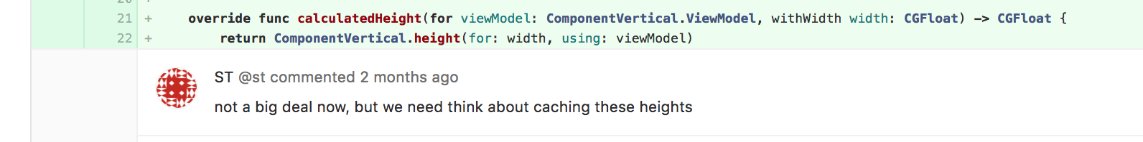
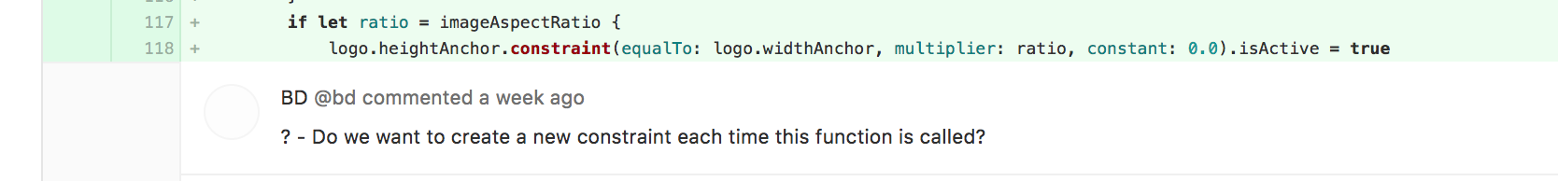
Performance
💪
Notes:
https://git.csnzoo.com/wayfair/wayfair-ios/merge_requests/7449
https://git.csnzoo.com/wayfair/wayfair-ios/merge_requests/8169
https://git.csnzoo.com/wayfair/wayfair-ios/merge_requests/7449 – Bonus for long discussion thread

Slide 14
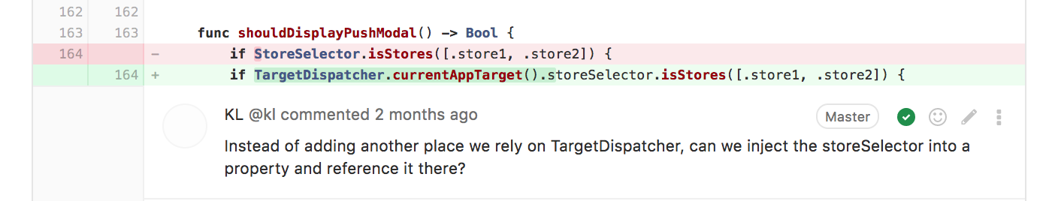
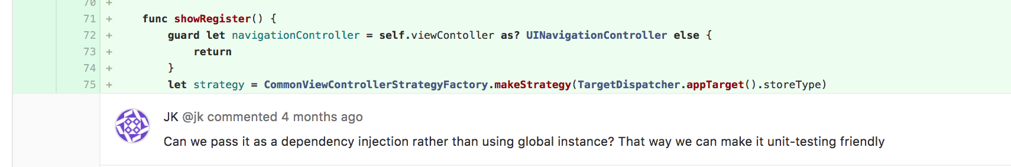
Testability
Notes:
Use of singleton inside the method. The code will be testable if we use dependency injection to pass the singleton instance instead which will make this code mockable
https://git.csnzoo.com/wayfair/wayfair-ios/merge_requests/7537
https://git.csnzoo.com/wayfair/wayfair-ios/merge_requests/6892

Slide 15
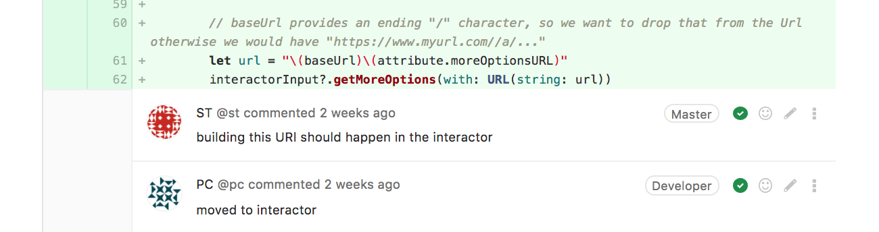
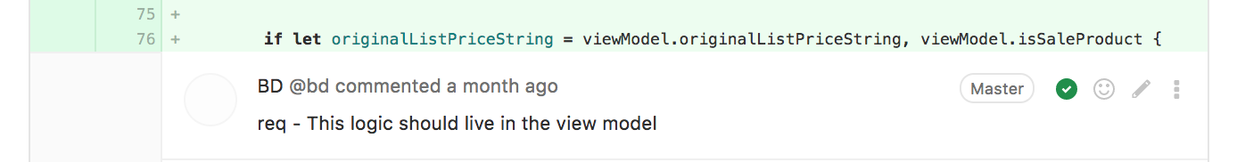
Architecture
🏗
Notes:
View and business layer should be separate. Business layer should contain logic and view layer should be concerned with just displaying data on the view port.
When developer is unfamiliar with the architecture, it’s usual to make such mistakes. A thorough code review can help to mitigate such cases
https://git.csnzoo.com/wayfair/wayfair-ios/merge_requests/7972

Slide 16
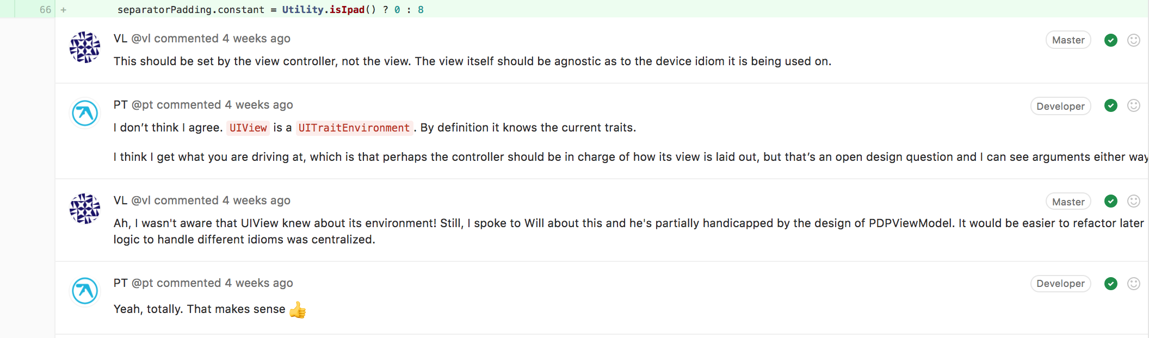
Discussion
Notes:
Developers are discussing about the best place to put logic to handle device based logic
Another developers replies with a reason why this decision was made the way it is and open to any further offline discussion
First developer suggests the refactor so that the logic to handle device type can be centralized
https://git.csnzoo.com/wayfair/wayfair-ios/merge_requests/8029
https://git.csnzoo.com/wayfair/wayfair-ios/merge_requests/7987

Slide 17
Do’s and Don’ts of Code Review

Slide 18
Do’s for a Code Reviewer
Be prepared to elaborate on review comments
Be professional, respectful, and understanding towards the reviewee
Notes:
- Be prepared to elaborate on review comments -- With examples and references
- Put emphasis on requests rather than commands
Use the words, please and emphasis on work we to highlight certain areas in MR. Use of we stresses the importance of team effort as opposed to you which can point the personal blame

Slide 19
Do’s for a Code Reviewer
Get acquainted with standard coding and style guidelines
Feel free to collaborate with other code reviewers
Notes:
- Get acquainted with standard coding and style guidelines -- Document
- Feel free to collaborate with other code reviewers -- Whenever necessary

Slide 20
Do’s for a Code Reviewee
Complete the merge request with all the necessary details
Make sure to fix merge conflicts
Locally run the code with tests and linter
Notes:
- Complete the merge request with necessary details -- Before submitting it for review
*
*

Slide 21
Do’s for a Code Reviewee
Be mindful to suggestions from the last review
Supply the merge request with annotations and inline code comments
Notes:
* Be mindful to suggestions from the last review -- And avoid repeating mistakes
* Supply the merge request with annotations and inline code comments-- That will give more in-depth context for reviewer. Add the feature –videos to the merge request

Slide 22
Don’ts for a Code Reviewer
Don't delay code reviews
Don't use your code reviews as a medium to discourage fellow developers
Notes:
- Don't delay code reviews – Communicate and reassign reviews ahead of time if you're unavailable
- Don't make scathing and personal remarks

Slide 23
Don’ts for a Code Reviewer
Don't apply instant, rubber-stamped approval
Don’t sacrifice quality for the sake of development pace
Notes:
- Rubber stamp approval could be added when developer is unfamiliar with the code, is busy, or needs something to merge as soon as possible
- here are times when release manager can ask you to merge something important such as hot fix. It’s code reviewer’s responsibility to make sure reviewee has thoroughly tested the code with possible edge cases, added unit tests wherever possible and does not introduce unwanted side-effects

Slide 24
Don’ts for a Code Reviewee
Don't take code reviews personally
Don't blame things pointed out during code review
Notes:
- Don't take code reviews personally -- Consider them to be a learning opportunity
"You are not your code" - meaning, your code can be mistaken, it can even be awful, it doesn't make you awful and it only reflects negatively on you if you don't improve.
Don't blame things pointed out during code review -- On someone else. If you are copy and pasting the code, you should be making improvements to original code. If changes are too time consuming and complex, make sure to create a ticket, put it in the backlog and consult with project manager for triaging them
Goal should be to leave the codebase in better state than what we found in the first place

Slide 25
Don’ts for a Code Reviewee
Don't ignore review comments
Don't place too much code in for a review at once
Notes:
- Don't ignore review comments - Follow-up if you need further explanation
Making smaller, self contained MRs. Have a branching strategy and follow it. - Be aggressive about getting to review early and often, and switch reviewers if people don't have time (while communicating as a team of course!)
Days instead of points

Slide 26
Conclusion and Takeaways
Essential
Learning
Documentation
Stability
Notes:
Essential: Code review is an integral part of any software engineering team, irrespective of the team’s size and domain. Helps to catch bugs and unforeseen issues arising from integration with other modules. Saves time by making early fixes, learning opportunity and enforces a consistent coding styles
Learning: It provides a great way to educate team members through constant feedback cycles. Opportunity to distribute knowledge about ideal programming practices and software architecture.
Documentation: Paves the way for documentation as code is written. Allow people to comment and have discussions that can be used for in-depth context for future references. Reviewer can also check for clear and informative MR description and comments for newly added classes and methods
* Stability: Properly executed code reviews produce secure and stable and adaptable code that results in end-user satisfaction in the long-term. Great way to verify if code is adaptable to variety of device and OSs and not just the selected subset..

Slide 27
Avoid Broken Windows Syndrome
Notes:
Vandalism public drinking lead to more serious crimes
Don't leave "broken windows" (bad designs, wrong decisions, or poor code) unrepaired. Fix each one as soon as it is discovered

Slide 28
THANKS!
@jayeshkawli
https://jayeshkawli.ghost.io
https://github.com/jayesh15111988
Notes:
If you want to follow me on Twitter
Link to my blog where I usually write about programming, travel and food
Link to GitHub repository where I host open source libraries and my side projects

Slide 29


Notes:
We are Wayfair and we are hiring, Some of our folks are here, for this conference. And here’s you can find us online and feel free to chat with us
www.wayfaircareers.com is our official careers website where you can apply to jobs that you might be interested in

